Slide 1
Usability Testing
November 13, 2017
Notes:
75 minutes 1st half (midterm review slides with remaining 50 minutes)

Slide 2
Outline
Why do usability testing?
Choosing participants
Ethical considerations
Designing & conducting the test
Using the results
Experimental options & details

Slide 3
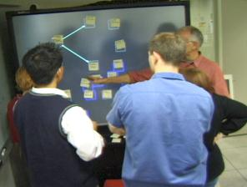

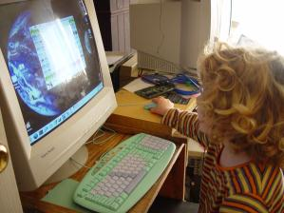
Why do Usability Testing?
Can’t tell how good UI is until?
people use it!
Expert review methods are based on evaluators who?
may know too much
may not know enough (about tasks, etc.)
Hard to predict what real users will do

Slide 4
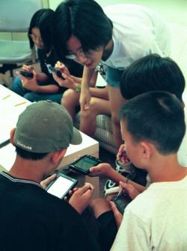
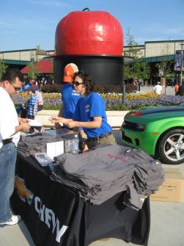
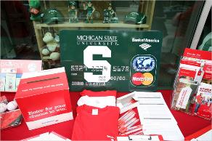
Choosing Participants
Representative of target users ?
job-specific vocab / knowledge
tasks
Approximate if needed
system intended for doctors?
get medical students or nurses
system intended for engineers?
get engineering students
Use incentives to get participants
T-shirt, mug, free coffee/pizza
Notes:
Michigan State Image from http://www.nytimes.com/2009/01/01/business/01student.html

Slide 5

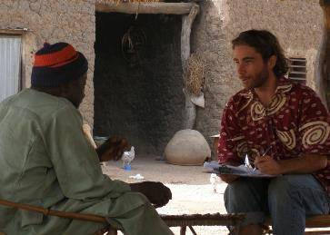
Ethical Considerations
Usability tests can be distressing
users have left in tears
Testing/fieldwork can be coercive if there is a power imbalance (e.g., in under resourced communities)
People may feel no option but to speak to you or give you their time even though they may not get anything of value in return.
http://centread.ucsc.edu/CenTREAD%20photos/BrianDowd2.JPG
Notes:
Doing fieldwork in under resourced communities has a number of pitfalls for researchers coming from an empowered group (whether by race, education, or other institutional privilege).
You cannot just drop in to some rural village wearing your African shirt. It just isn’t ethical.
Even paying money can be coercive because they may NOT be able to turn you down

Slide 6

Ethical Considerations
Usability tests can be distressing
users have left in tears
Testing/fieldwork can be coercive if there is a power imbalance (e.g., in under resourced communities)
“the ‘at-risk’ label is highly problematic and often implicitly racist and classist… [it] locates problems in individuals, families, and communities, rather than in institutional structures that create and maintain inequality.”
http://centread.ucsc.edu/CenTREAD%20photos/BrianDowd2.JPG
http://www.sunypress.edu/
Notes:
Further, even the terminology we use in these situations might be holding people back.
http://www.sunypress.edu/p-2029-children-and-families-at-promis.aspx
This book shows how the labeling of children as "at-risk" actually perpetuates the inequities, racism, and discrimination facing many families in America. This book critiques the currently popular "at-risk" construct, drawing from historical, contextual, critical, and personal perspectives. It provides an alternative context for viewing children and their families as "at-promise." A basic premise of the book is that the generalized use of the "at-risk" label is highly problematic and often implicitly racist and classist--a 1990s version of the cultural deficit model that locates problems in individuals, families, and communities, rather than in institutional structures that create and maintain inequality. This book provides a needed interrogation and alternative context for viewing children and families caught in the extreme conditions facing many families in the United States.

Slide 7
Ethical Considerations
Usability tests can be distressing
users have left in tears
Testing/fieldwork can be coercive if there is a power imbalance (e.g., in under resourced communities)
“When the interviewer is a foreign researcher requiring a translator, the bias towards the interviewer’s artifact increases to 5x.”
http://centread.ucsc.edu/CenTREAD%20photos/BrianDowd2.JPG
http://www.sunypress.edu/
http://research.microsoft.com/pubs/163718/CHI2012-Dell-ResponseBias-proc.pdf
Notes:
Finally, the results you get might simply be wrong.
Nicki Dell on Participant Response Bias.
Although HCI researchers and practitioners frequently work with groups of people that differ significantly from themselves, little attention has been paid to the effects these differences have on the evaluation of technological systems. Via 450 interviews in Bangalore, India, we measure participant response bias due to interviewer demand characteristics and the role of social and demographic factors in influencing that bias. We find that respondents are about 2.5x more likely to prefer a technological artifact they believe to be developed by the interviewer, even when the alternative is identical. When the interviewer is a foreign researcher requiring a translator, the bias towards the interviewer’s artifact increases to 5x. In fact, the interviewer’s artifact is preferred even when it is degraded to be obviously inferior to the alternative. We conclude that participant response bias should receive more attention within the CHI community, especially when designing for underprivileged populations.

Slide 8

Ethical Considerations
You have a responsibility to alleviate these issues
make voluntary with informed consent (form)
avoid pressure to participate
let them know they can stop at any time
stress that you are testing the system, not them
make collected data as anonymous as possible
Often must get human subjects approval (IRB)
http://research.uthscsa.edu/irb/images/IRBmeeting4.jpg

Slide 9
Usability Test Proposal
A report that contains
objective
description of system being testing
task environment & materials
participants
methodology
tasks
test measures
Get approved & then reuse for final report
Seems tedious, but writing this will help “debug” your test

Slide 10

Selecting Tasks
Tasks from low-fi design can be used
may need to shorten if
they take too long
require background that test user won’t have
Don’t train unless that will occur in real deployment
Avoid bending tasks in direction of what your design best supports
Don’t choose tasks that are too fragmented ?
fragmented = do not represent a complete goal someone would try to accomplish with your application
e.g., phone-in bank test
Check if your friend has called, find out what time he will be goin o the club.

Slide 11


Two Types of Data to Collect
Process data
observations of what users are doing & thinking
qualitative
Bottom-line data
summary of what happened
time, errors, success
i.e., the dependent variables
quantitative
http://allazollers.com/discovery-research.php
http://www.fusionfarm.com/content/uploads/2012/10/analyzing-data.jpg

Slide 12
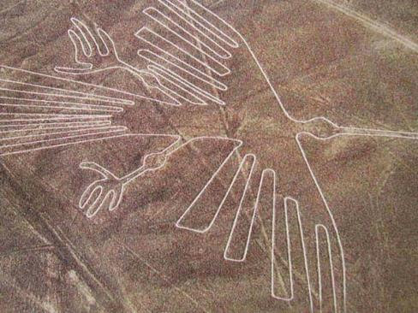
Which Type of Data to Collect?
Focus on process data first
gives good overview of where problems are
“It’s hard to see things when you're too close. Take a step back and look.” —Bob Ross
http://www.redicecreations.com/ul_img/24592nazca_bird.jpg
Notes:
One of the most mysterious places on Earth, the Nazca Lines in Peru are pictographs etched in the desert.
http://www.azquotes.com/quote/1137013

Slide 13

Which Type of Data to Collect?
Focus on process data first
gives good overview of where problems are
Bottom-line doesn’t tell you ?
where to fix
just says: “too slow”, “too many errors”, etc.
Hard to get reliable bottom-line results
need many users for statistical significance
http://netbreak-ph.blogspot.com/2012/09/Hitleap-get-traffic-views-on-site.html

Slide 14

The “Thinking Aloud” Method
Need to know what users are thinking, not just what they are doing
Ask users to talk while performing tasks
tell us what they are thinking
tell us what they are trying to do
tell us questions that arise as they work
tell us things they read
I’ll click on the checkout button

Slide 15
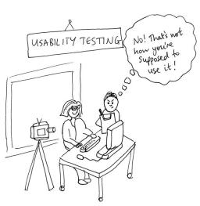
Thinking Aloud (cont.)
Prompt the user to keep talking
“tell me what you are thinking”
Only help on things you have pre-decided
keep track of anything you do give help on
Make a recording and take good notes
make sure you can tell what they were doing
use a digital watch/clock
record audio & video
or even event logs
http://jennycham.co.uk/wp-content/uploads/2011/08/200911221250225481.jpg

Slide 16
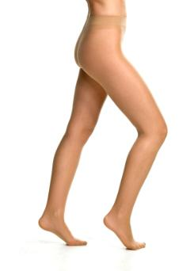
Will thinking out loud give the right answers?
Not always
If you ask, people will always give an answer, even it is has nothing to do with facts
panty hose example
→Try to avoid specific questions (especially that have binary answers)
Cues can help: Maier’s Reasoning Expt.
Notes:
Did an experiment: had someone sit outside a supermarket with 2 pairs of pantyhose and asked which was more sheer
There was a statistically significant different between the one on the right and left
…but they were the same product!
Moral: be careful what you ask – people will try to give you the answer they think you want
Also Ma

Slide 17
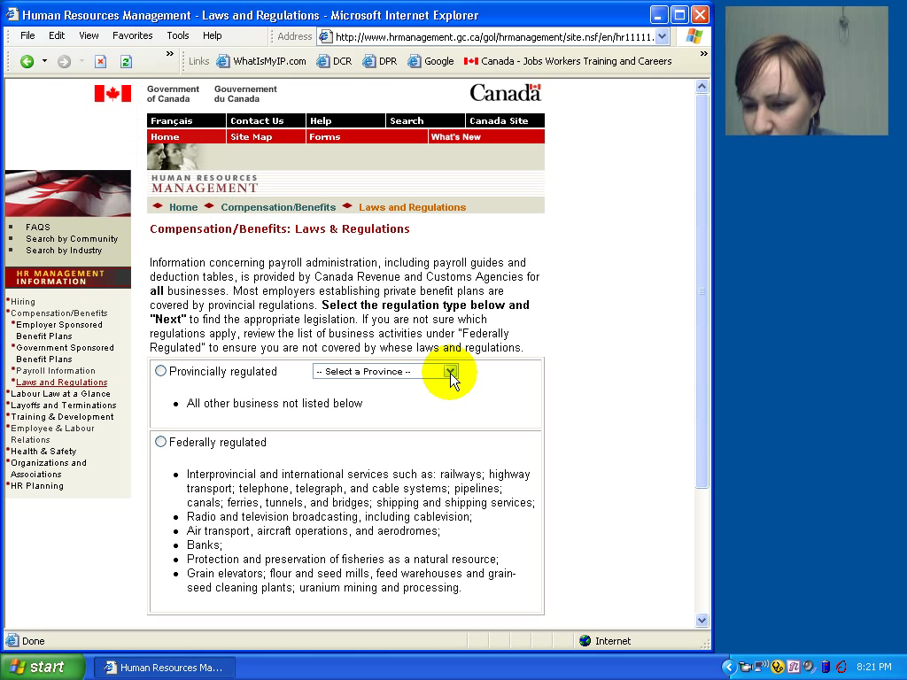
Notes:
Watch her face and listen to the tone of her voice. These are the types of things you cannot get with A/B testing or other more automated methodologies that we will talk about later.

Slide 18

Using the Test Results
Summarize the data
make a list of all critical incidents (CI)
positive & negative
include references back to original data
try to judge why each difficulty occurred
What does data tell you?
UI work the way you thought it would?
users take approaches you expected?
something missing?
http://www.hhs.gov/ocr/privacy/hipaa/enforcement/data/index.html

Slide 19
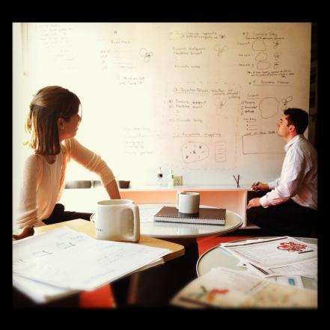
Using the Results (cont.)
Update tasks & rethink design
rate severity & ease of fixing CIs
fix both severe problems & make the easy fixes
http://www.thetomorrowplan.com/exchange/policies-prairie-chickens-and-parking/

Slide 20
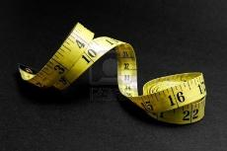
Measuring Bottom-Line Usability
Situations in which numbers are useful
time requirements for task completion
successful task completion %
compare two designs on speed or # of errors
Ease of measurement
time is easy to record
error or successful completion is harder
define in advance what these mean
Do not combine with thinking-aloud. Why?
talking can affect speed & accuracy

Slide 21

Analyzing the Numbers
Example: trying to get task time ≤ 30 min.
test gives: 20, 15, 40, 90, 10, 5
mean (average) = 30
median (middle) = 17.5
looks good!
Did we achieve our goal?
Wrong answer, not certain of anything!
Factors contributing to our uncertainty?
small number of test users (n = 6)
results are very variable (standard deviation = 32)
std. dev. measures dispersal from the mean

Slide 22
Analyzing the Numbers (cont.)
This is what statistics is for
Crank through the procedures and you find
95% certain that typical value is between 5 & 55
Notes:
95% (or alpha=5%) is the standard confidence interval used in HCI

Slide 23
Analyzing the Numbers (cont.)

Slide 24
Analyzing the Numbers (cont.)
This is what statistics is for
Crank through the procedures and you find
95% certain that typical value is between 5 & 55
Usability test data is highly variable
need lots to get good estimates of typical values
4x as many tests will only narrow range by 2x
breadth of range depends on sqrt of # of test users
this is when online methods become useful
easy to test w/ large numbers of users

Slide 25
Measuring User Preference
How much users like or dislike the system
can ask them to rate on a scale of 1 to 10
or have them choose among statements
“best UI I’ve ever…”, “better than average”…
hard to be sure what data will mean
novelty of UI, feelings, not realistic setting …
If many give you low ratings → trouble
Can get some useful data by asking
what they liked, disliked, where they had trouble, best part, worst part, etc.
redundant questions are OK

Slide 26
Comparing Two Alternatives
Between groups experiment
two groups of test users
each group uses only 1 of the systems
Within groups experiment
one group of test users
each person uses both systems
can’t use the same tasks or order (learning)
best for low-level interaction techniques
e.g., new mouse, new swipe interaction, …
B
A

Slide 27
Comparing Two Alternatives
Between groups requires many more participants than within groups
See if differences are statistically significant
assumes normal distribution & same std. dev.
Online companies can do large AB tests
look at resulting behavior (e.g., buy?)

Slide 28
Experimental Details
Order of tasks
choose one simple order (simple → complex)
unless doing within groups → counterbalance order
Training
depends on how real system will be used
What if someone doesn’t finish
assign very large time & large # of errors or remove & note
Pilot study
helps you fix problems with the study
do two, first with colleagues, then with real users

Slide 29
Instructions to Participants
Describe the purpose of the evaluation
“I’m testing the product; I’m not testing you”
Tell them they can quit at any time
Demonstrate the equipment
Explain how to think aloud
Explain that you will not provide help
Describe the task
give written instructions
one task at a time
Check if your friend has called, find out what time he will be goin o the club.
Notes:
Try to get the variance down by being consistent in how you do these things.

Slide 30
Details (cont.)
Keeping variability down
recruit test users with similar background
brief users to bring them to common level
perform the test the same way every time
don’t help some more than others (plan in advance)
make instructions clear
Debriefing test users
often don’t remember, so demonstrate or show video segments
ask for comments on specific features
show them screen (online or on paper)

Slide 31
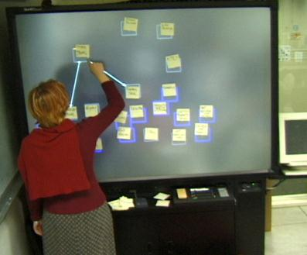
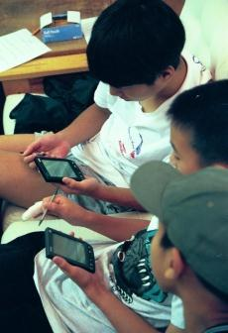
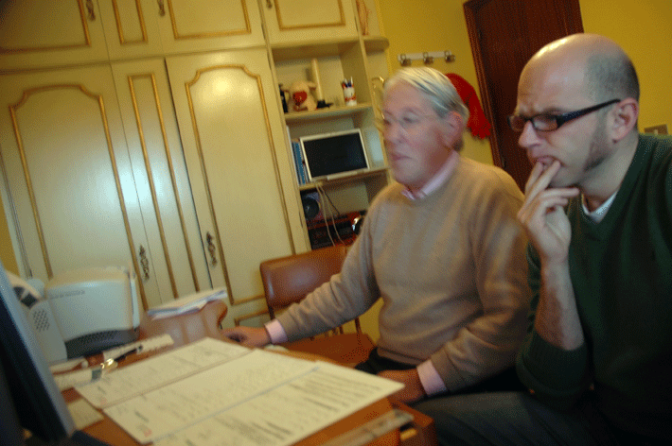
Reporting the Results
Report what you did & what happened
Images & graphs help people get it!
Video clips can be quite convincing

Slide 32
Heuristic Evaluation vs. User Testing
HE is much faster
1-2 hours each evaluator vs. days-weeks
HE doesn’t require interpreting user’s actions
User testing is far more accurate (by def.)
takes into account actual users and tasks
HE may miss problems & find “false positives”
Good to alternate between HE & user testing
find different problems
don’t waste participants

Slide 33
Summary
User testing is important, but takes time/effort
Use ????? tasks & ????? participants
real tasks & representative participants
Be ethical & treat your participants well
Want to know what people are doing & why? collect
process data
Bottom line data requires ???? to get statistically reliable results
more participants
Difference between between & within groups?
between groups: everyone participates in one condition
within groups: everyone participates in multiple conditions

Slide 34
Further Reading on Ethical Issues With Community-based Research
Children and Families “At Promise, Beth B. Swadener, Sally Lubeck, editors, SUNY Press, 1995, http://www.sunypress.edu/p-2029-children-and-families-at-promis.aspx
“Yours is better!” Participant Response Bias in HCI, Proceedings of CHI 2012, by Nicola Dell, et al., http://research.microsoft.com/pubs/163718/CHI2012-Dell-ResponseBias-proc.pdf
“Strangers at the Gate: Gaining Access, Building Rapport, and Co-Constructing Community-Based Research”, Proceedings of CSCW 2015, by Christopher A. Le Dantec & Srah Fox, http://dl.acm.org/citation.cfm?id=2675133.2675147&coll=DL&dl=ACM
“Imperialist Tendencies” blog post by Jan Chipchase, http://janchipchase.com/content/essays/imperialist-tendencies/
“To Hell with Good Intentions” by Ivan Illich, speech to the Conference on InterAmerican Student Projects (CIASP), April 20, 1968, http://www.swaraj.org/illich_hell.htm

